Slide 1
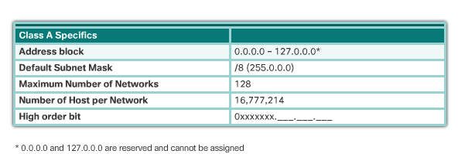
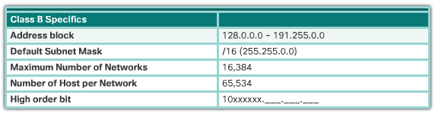
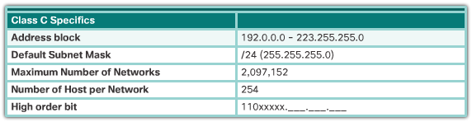
Legacy Classful Addressing
Notes:
7.1.4.4 Legacy Classful Addressing
7.1.4.5 Video Demonstration - Classful IPv4 Addressing

Slide 2
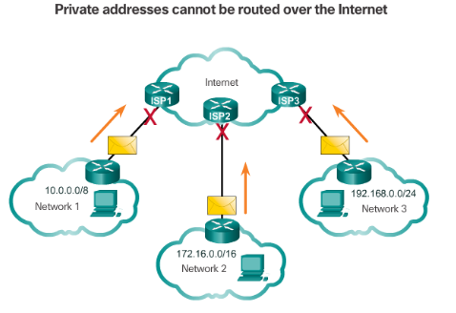
Public and Private IPv4 Addresses
Private Addresses:
10.0.0.0/8 or 10.0.0.0 to10.255.255.255
172.16.0.0 /12 or 172.16.0.0 to 172.31.255.255
192.168.0.0 /16 or 192.168.0.0 to 192.168.255.255
Notes:
7.1.4.1 Public and Private IPv4 Addresses
7.1.4.2 Activity – Pass or Block IPv4 Addresses

Slide 3
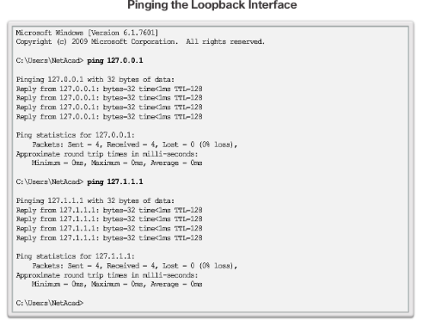
Special Use IPv4 Addresses
Loopback addresses 127.0.0.0 /8 or 127.0.0.1 to 127.255.255.254
Link-Local addresses or Automatic Private IP Addressing (APIPA) addresses 169.254.0.0 /16 or 169.254.0.1 to 169.254.255.254
TEST-NET addresses 192.0.2.0/24 or 192.0.2.0 to 192.0.2.255
Notes:
7.1.4.3 Special Use IPv4 Addresses

Slide 4
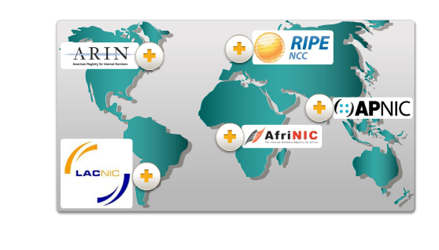
Assignment of IP Addresses
Notes:
7.1.4.7 Assignment of IP Addresses
7.1.4.8 Activity – Public or Private IPv4 Address
7.1.4.9 Lab – Identifying IPv4 Addresses

Slide 5
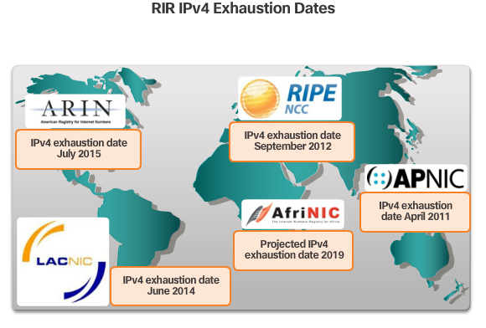
The Need for IPv6
Notes:
7.2.1.1 The Need for IPv6

Slide 6
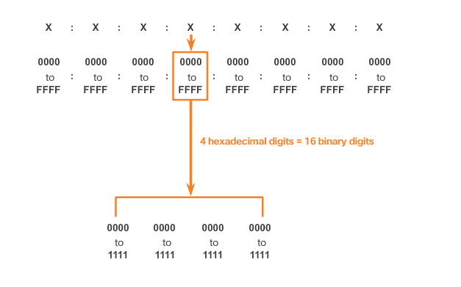
IPv6 Address Representation
Hextets – 4 Hexadecimal digits = 16 binary digits
Notes:
7.2.2.1 IPv6 Address Representation

Slide 7
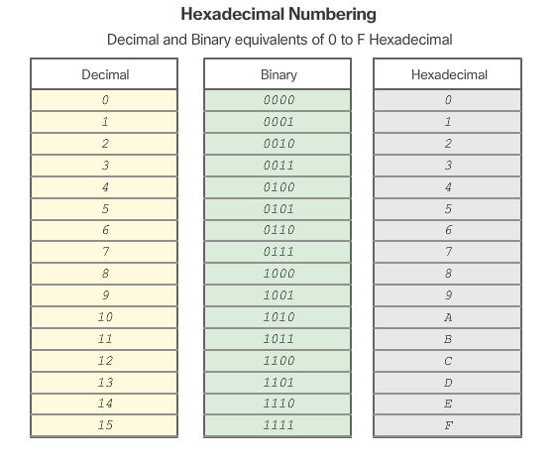
IPv6 Address Representation (cont.)
Notes:
7.2.2.1 IPv6 Address Representation (Cont.)

Slide 8
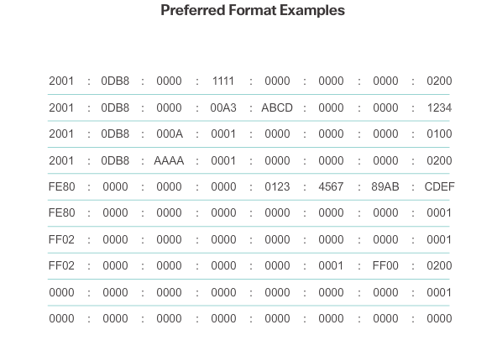
IPv6 Address Representation (cont.)
Notes:
7.2.2.1 IPv6 Address Representation (Cont.)

Slide 9
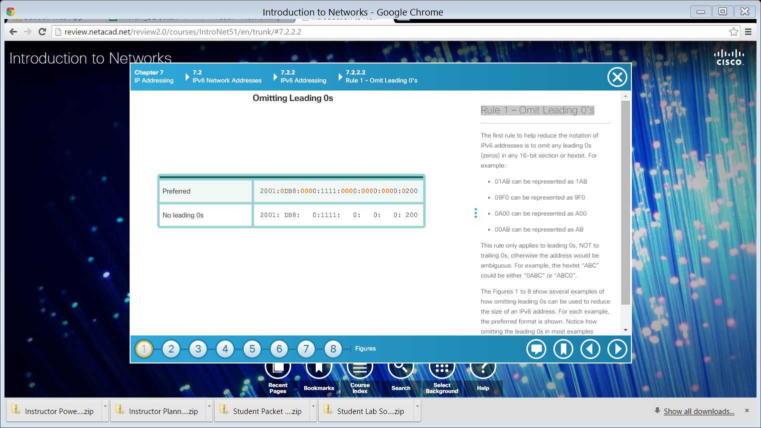


Rule 1 – Omit Leading 0’s
Example 1
Example 2
Example 3
Notes:
7.2.2.2 Rule 1 – Omit Leading 0’s

Slide 10

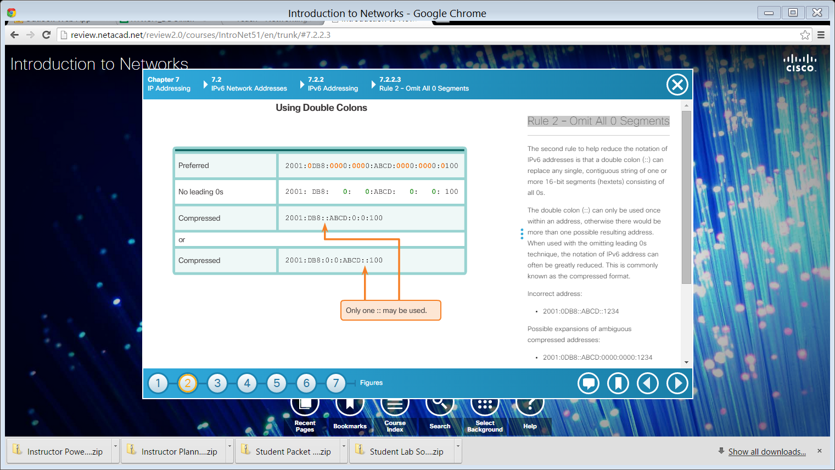
Rule 2 – Omit All 0 Segments
Example 1
Example 2
Notes:
7.2.2.3 Rule 2 – Omit All 0 Segments

Slide 11


Rule 2 – Omit All 0 Segments (cont.)
Example 3
Example 4
Notes:
7.2.2.3 Rule 2 – Omit All 0 Segments (Cont.)
7.2.2.4 Activity – Practicing IPv6 Address Representations

Slide 12
Ipv6 – 128-bit hexa-decimal
Shortage of ip addresses
1999 June
No need of nat
No subnetting
Larger address space – 2 power 128
Aggregation based address
No more brOadcast

Slide 13
Built in support for mobile ip
Built in ip security
Multiple ip addresses per interface
Total 8 portions
Every portion 16 bits
Each number 4 bits
First 64 bits – global prefix value
Second 64 bits – interface id

Slide 14
Default prefix value is 64 bit
Continues “0” s as double column
double column only once allowed in ipv6
Unicast
Multicast
Anycast
Unicast – normal communication address
Multicast – one to group
Anycast

Slide 15
Global unicast address – PUBLIC IP
Unique local address – Private IP
Link local address – non routable
Global unicast – 2000::/3 (first 3 bits are 001 assigned by iana)
Address starts with 2 or 3 is global unicast address
UNIQUE LOCAL – FC00::/7
UNIQUE LOCAL – NOT ROUTABLE ON INTERNET
UNIQUE LOCAL – STARTS WITH FC OR FD

Slide 16
lINK LOCAL – DEAFULT IPV6 ADDRESS
lINK LOCAL – ALONG WITH MANUAL IP
lINK LOCAL – NON-ROUTABLE
lINK LOCAL – FE80::/10
MULTICAST – FF00::/8
ANYCAST – NO VIRTUAL CLUSTER IP CONCEPT
UNIQUE LOCAL OR GLABAL UNICAST ADDRESS CAN BE USED AS ANYCAST.

